Slide 1
CODE HUNT
PRESENTS
COLORMANIA
Team Members:-
Gitanjali
Prajjwal
Azhan
Sukriti Sood

Slide 2
TECHNOLOGY USED
HTML
CSS
JAVASCRIPT

Slide 3
ABOUT GAME
This Game is about checking your speed and reflexes. It is 20 Round Game. In each Round fixed time is given to guess colour. Scores are given according to time taken by player.
It is interesting😁
Must Play

Slide 4
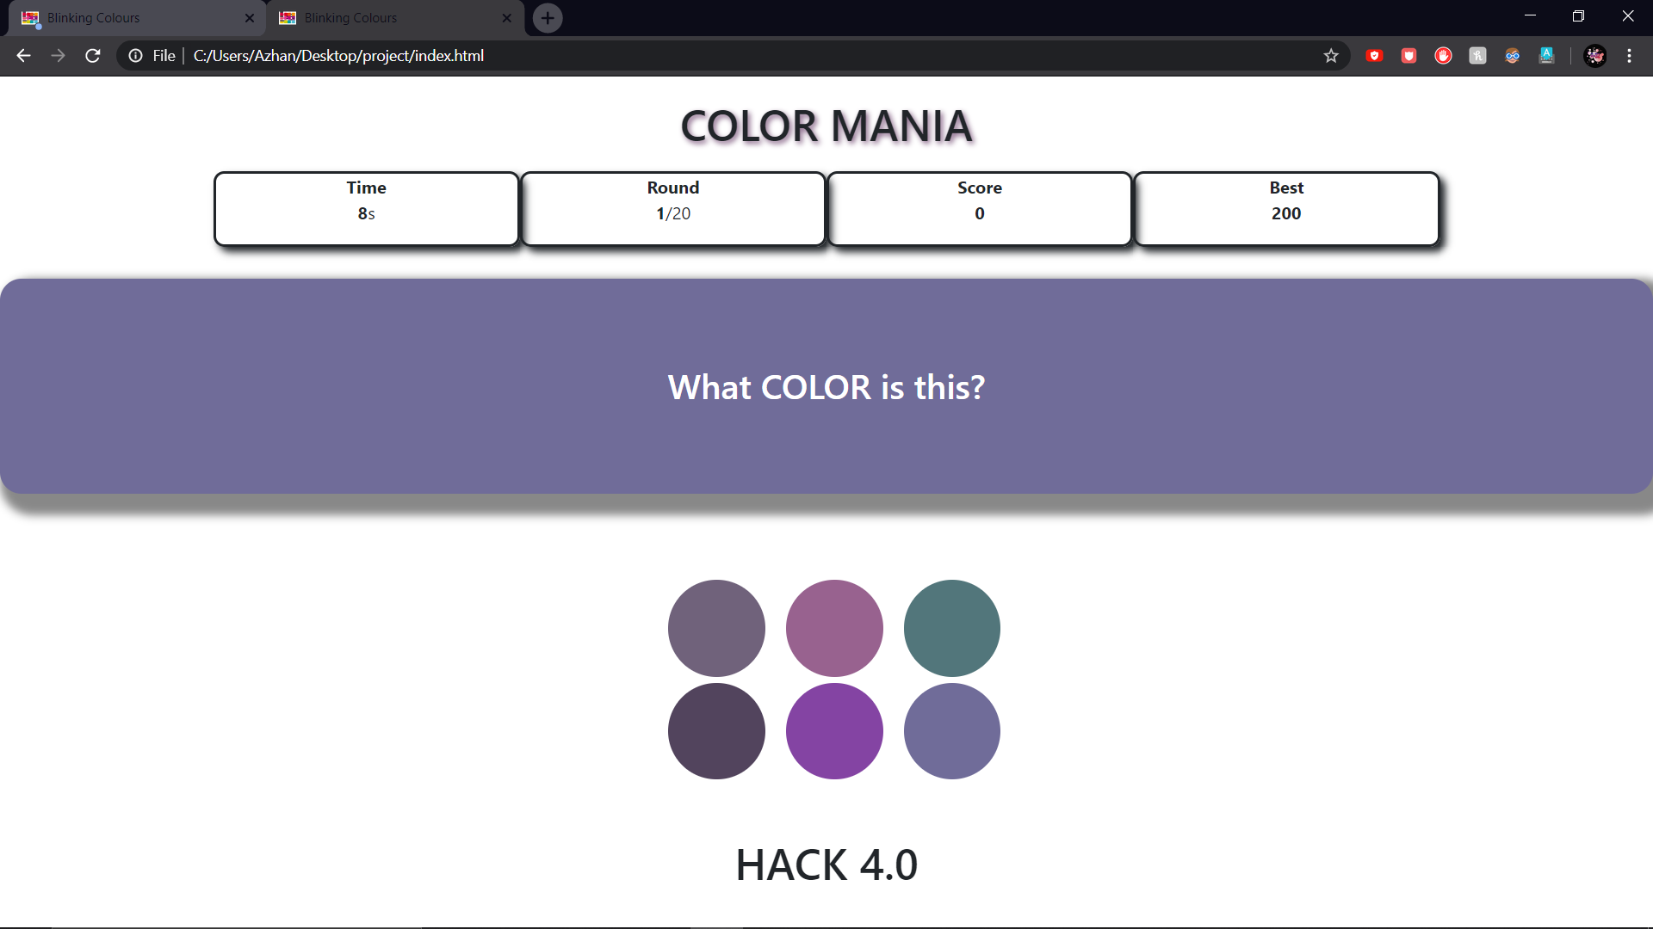

Slide 5
DEMONSTRATION

Slide 6
THANK YOU 😊

